Slide 1
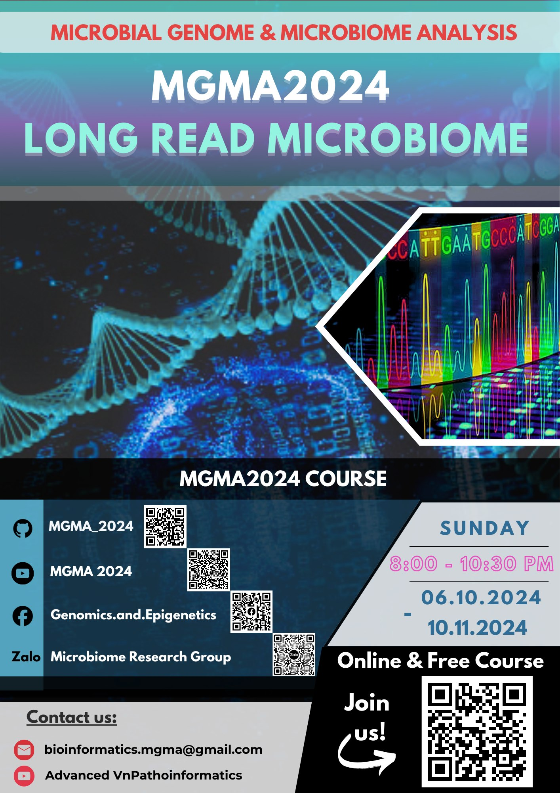

Slide 2













TEAM TRỢ GIẢNG
Nguyễn Quang Khải
nguyenkhai12330@gmail.com
Hà Gia Huy
hagiahuy311@gmail.com
Hồ Phú Quý
hophuquy0944@gmail.com
Hoàng Sơn
hoangsonltt710@gmail.com
Minh Nguyễn
ducminhnguyenle30091996@gmail.com
Nguyễn Quỳnh Như
Lucianhu@gmail.com
Mỹ Quí
ttmqui1912@gmail.com
Duy Đào
khuongduying@gmail.com
Ngô Đại Phú
phudaingobio@gmail.com
Tuệ An
anhvo.bio@gmail.com
Cao Phương Thảo
phuongthaocao2311@gmail.com
Nguyễn Mạnh Hùng
hungtrangan141@gmail.com
Phan Tấn Phát

Slide 3





TEAM HẬU CẦN
Hoàng Kim
vanhohoangkim@gmail.com
Nguyễn Lê Quang
quanglequang2003@gmail.com
Trần Thái Huy
BTBTIU21058@student.hcmiu.edu.vn
Huỳnh Khôi Minh Uyên
uyenhuynhkhoiminh.1.1@gmail.com
Mai Lê Chí Bảo maibao3011@gmail.com

Slide 4
Content
Review of MGMA2024
MODULE 1: MICROBIAL GENOME
MODULE 2: MICROBIOME ANALYSIS
Introduction LONG READ platforms
Overview of the course MGMA2024
MODULE 3: LONG READ MICROBIOME ANALYSIS
16S full-length ONT (Kim + Khải)

Slide 5
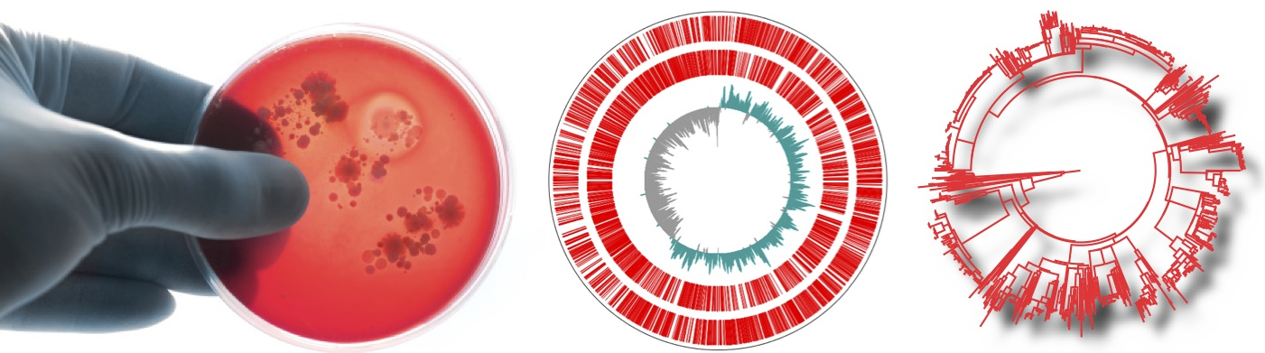
Microbial Genome Analysis: study one isolate at once
Culture microbe
Genome Sequencing
Serotyping/genotyping
Microbe = Microorganism Prokaryotes = Bacteria & Archaea

Slide 6
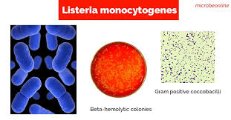
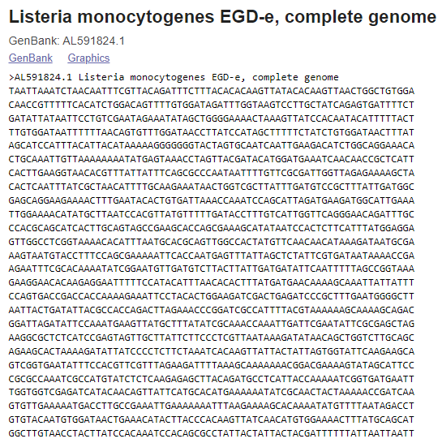
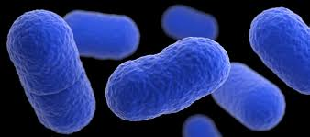

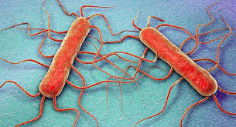
https://www.ncbi.nlm.nih.gov/nuccore/AL591824.1?report=fasta

Slide 7
Review of MGMA2024 MODULE 1: MICROBIAL GENOME
Basic Ubuntu OS
Basic Linux Commands
Bash Scripting
Basic Awk
Programming with R
Basic VScode, Colab and GitHub
Sanger Sequencing and Next Generation Sequencing platforms
(Pacbio, Element Biosciences, Ion Torrent, GeneMind, ILLUMINA and MGI)
Nucleotide sequence database: DNA and RNA
Homology Search with BLAST
Primer and Probe Design
Multiple Alignment
Phylogenetic Trees
Pairwise and Multiple genome alignment with Mauve
Gene and Genome Annotation
Mapping for Whole genome sequencing analysis of Microbes
Denovo assembly for WGS of Microbes
Serotyping, genotyping and phenotyping for Microbes
https://github.com/UeenHuynh/MGMA_2024

Slide 8
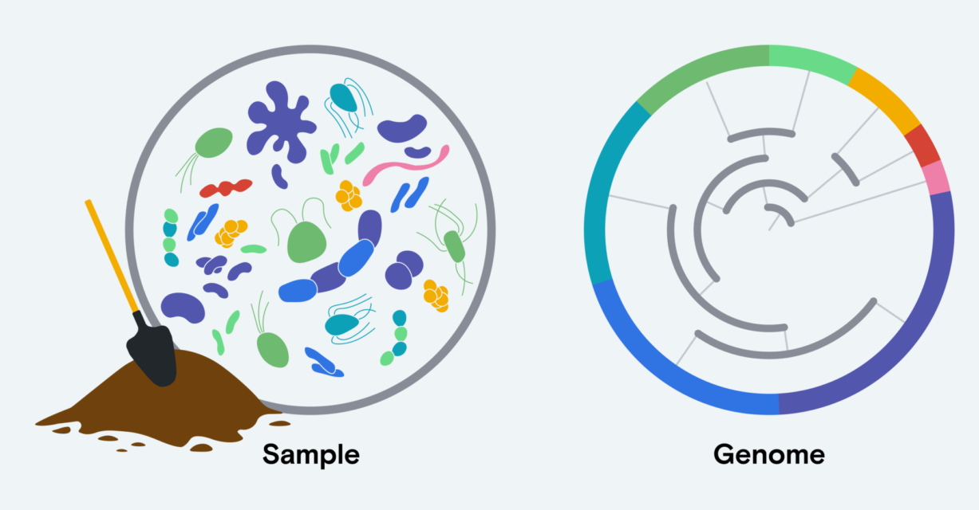
Microbiome Analysis or Metagenomics
https://www.elementbiosciences.com/blog/2-x-300-sequencing-all-the-reads-you-need-for-metagenomics

Slide 9
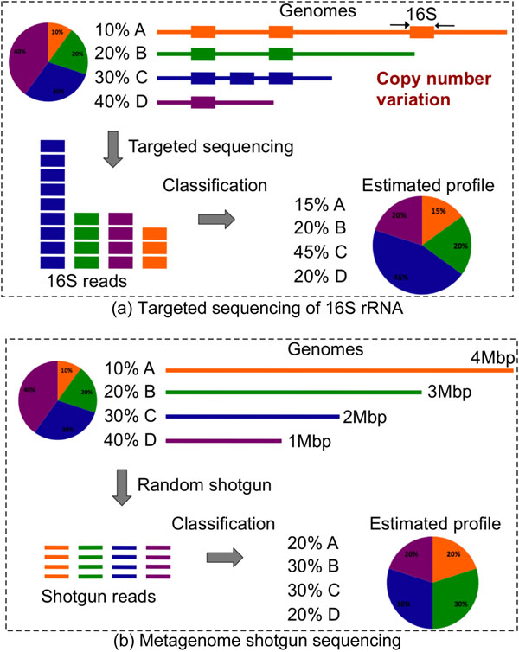
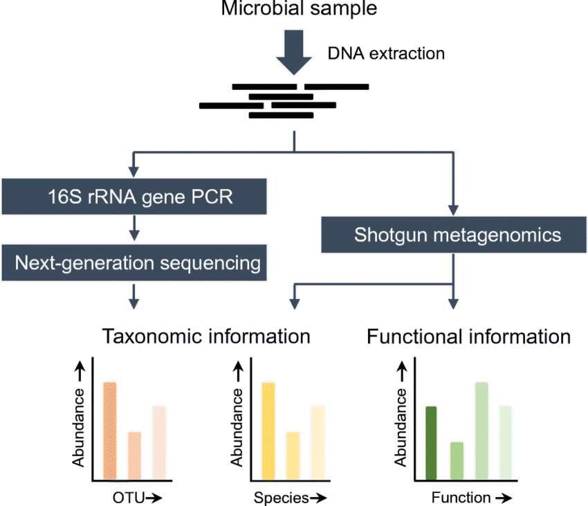
Target vs Shotgun Microbiome Analysis
10.1186/1471-2164-12-S2-S4
10.1007/s10096-019-03520-3

Slide 10
Review of MGMA2024 MODULE 2: MICROBIOME ANALYSIS
R for Microbiome Data
ggplot2
Experimental Design for Microbiome studies
Challenging when working with microbiome samples
Bioinformatic Analysis of Microbiome Data (QIIME 2)
Building feature table and feature representative sequences from raw reads
Assigning Taxonomy & Building Phylogenetic Tree
Clustering Sequences into OTUs
OTU Methods in Numerical Taxonomy
Alpha Beta diversity & Visualization
Library prep and multiplexing for 16S and shotgun metagenomics
Shotgun metagenomic Bioinformatic Analysis
Microbiome Application
https://github.com/UeenHuynh/MGMA_2024

Slide 11





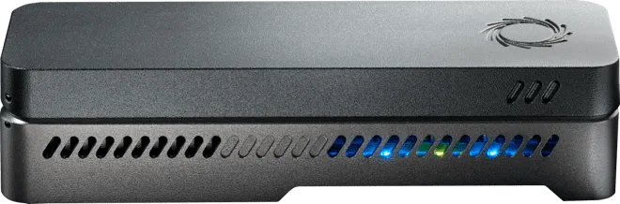
Introduction LONG READ platforms
MinION
CycloneSEQ
Revio system

Slide 12
Overview of the course MGMA2024 MODULE 3: LONG READ MICROBIOME ANALYSIS
CN: 06/10 (20h-22h30)
Overview of the course
Review old lecture MGMA
Introduction new platform
16S full-length ONT (Kim + Khải)
CN: 13/10 (20h-22h30)
shotgun ONT (Quý + Như)
CN: 20/10 (20h-22h30)
20h - 21h30: ONT Platform introduction
21h30 - 22h30: De novo assembly + mapping + variant calling ONT WGS (Huy + Phát)
CN: 27/10 (20h-22h30)
20h - 21h30: Pacbio Platform introduction (Mr. Ray)
21h30 -22h30 : 16S full-length PacBio (Hùng + Thảo)
CN: 03/11 (20h-22h30)
shotgun Pacbio (Sơn + Tuệ An)
CN: 10/11 (20h-22h30)
De novo assembly + mapping + variant calling PacBio WGS (Hùng + Thảo)
CN: 17/11 (20h-22h30)
CycloneSEQ Platform introduction
https://github.com/UeenHuynh/MGMA_2024

